Slide 1
App Store Optimization (ASO)
Android is open source while Apple is Close source.
Android apps are searchable on google.

Slide 2
Keyword Research
Competitor keyword results.
Unique Name.

Slide 3
ASO: Title
30-50 characters are used in title.
For e.g: free books & stories – Wattpad
If anyone search free books or free stories so your app will also shown.
For e.g: Duolingo: learn languages free so, if anyone search learn free languages this app will shone.
App title is most important part of ASO.
3 Targeted Keywords

Slide 4
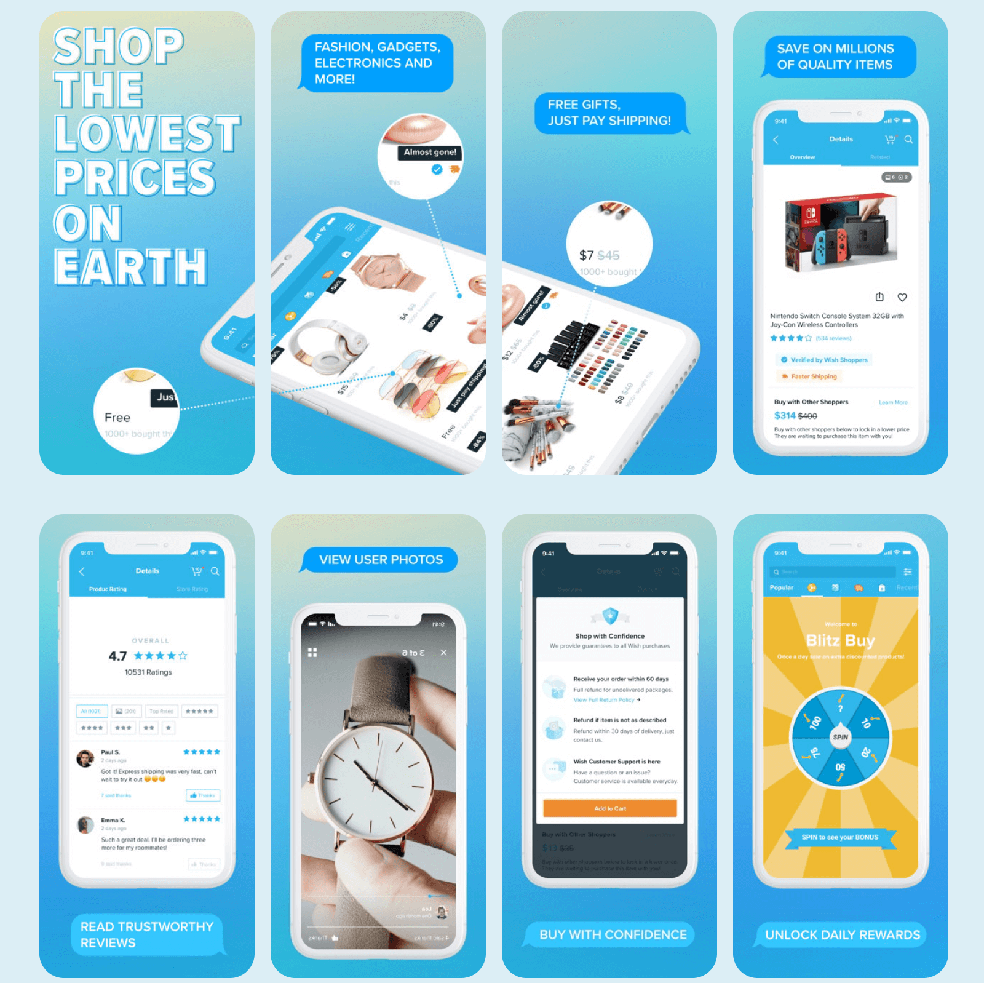
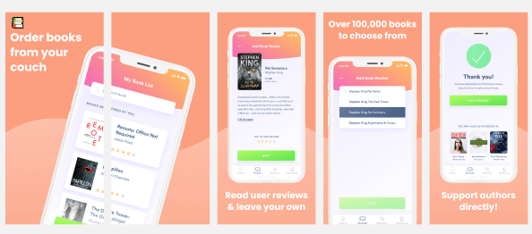
App icons & Screenshots
Use attractive icons.
Screen shots is very important for your app.
How to use app is also the part of your screen
Shots.

Slide 5
Description
Explain your app in very effective manner.
Minimum 1000 words.
Use paragraphs and bullets in your description.

Slide 6
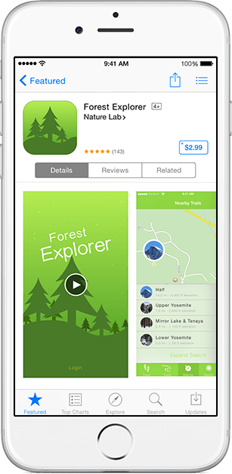
App preview
Add preview video of your app.
30sec-1min max.

Slide 7
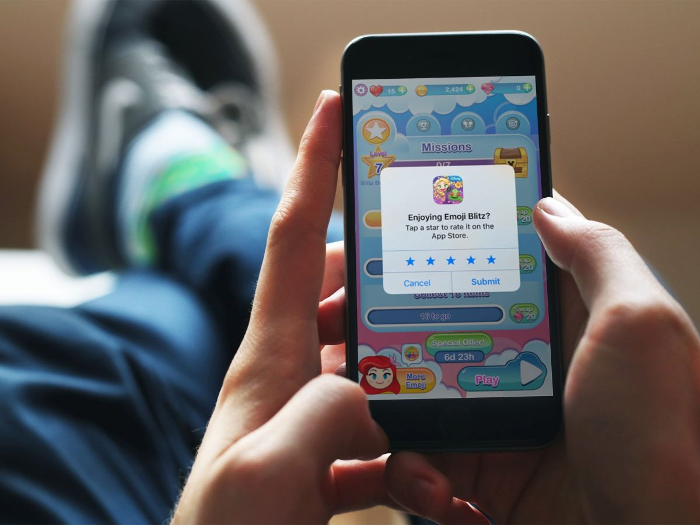
Rating & Review
Add rating option in your app.

Slide 8
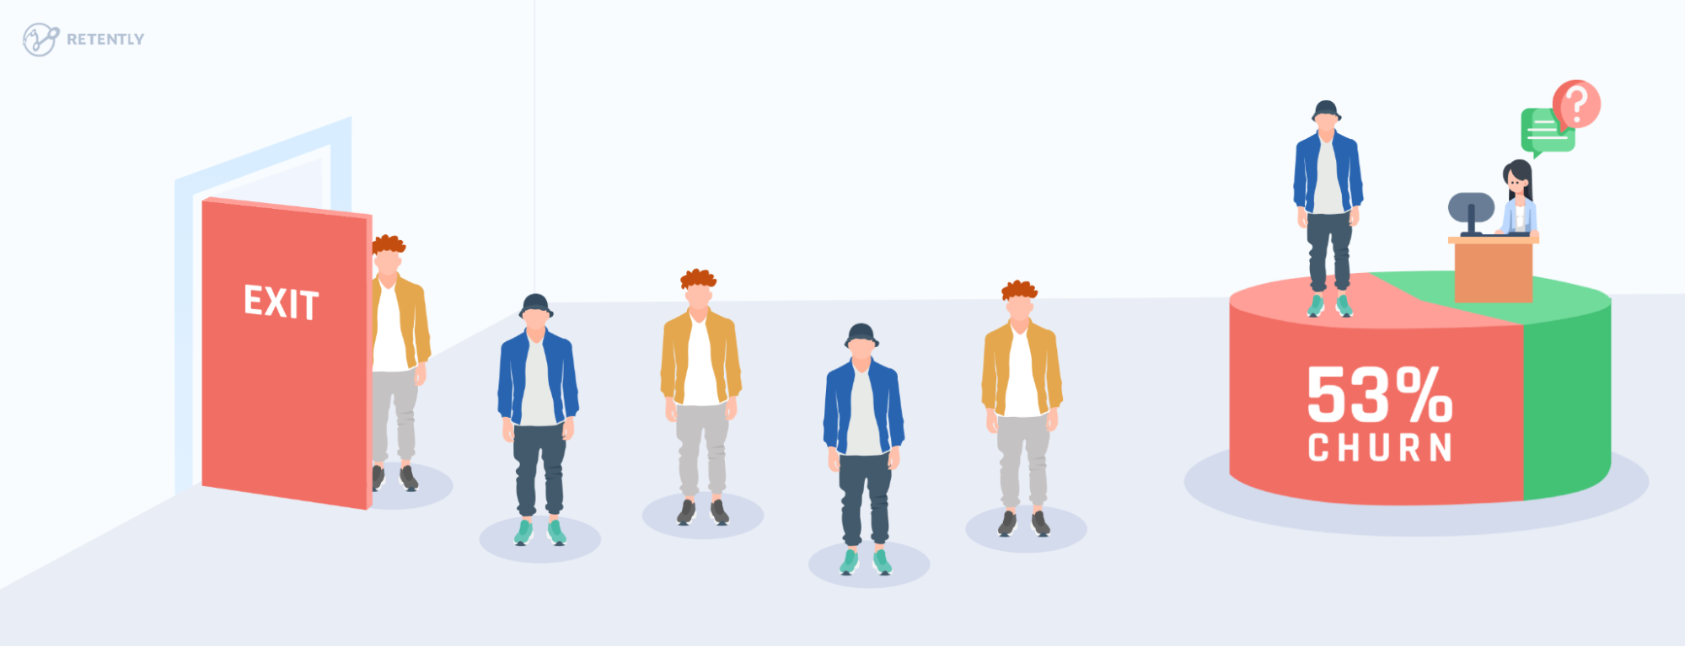
ASO-Retention
App should be use by users.
Check churn Rate of your app.
(for e.g download == uninstall so it’s bad)
you start January with 600 users, and at the end of the month, you have 400 users.Here’s how you would calculate your app churn rate: (600-400)/600 = 33.33% churn rate.

Slide 9
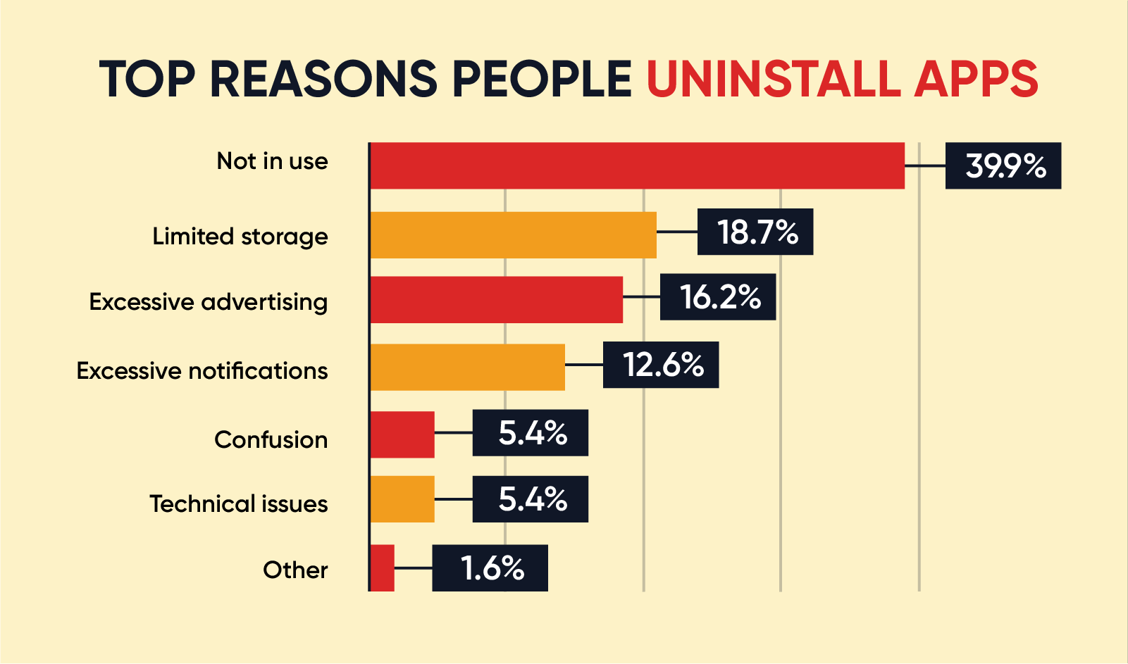
What Causes Churn

Slide 10
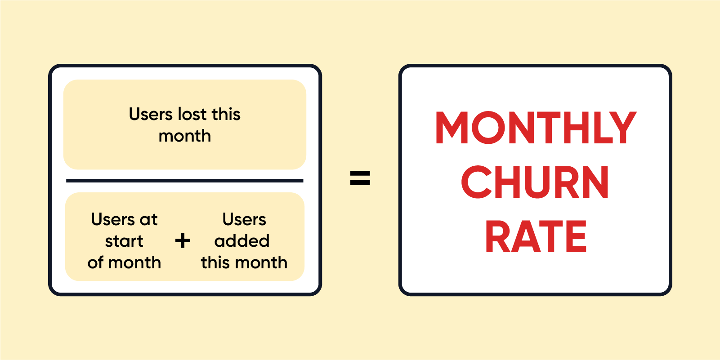
Monthly Churn Rate Calculation
Here’s a Monthly Churn Rate Example:
Users at start of month: 2,000 New users added that month: 400 Users lost at the end of month: 366 Monthly churn rate: 366/2,400 = 15.2%

Slide 11
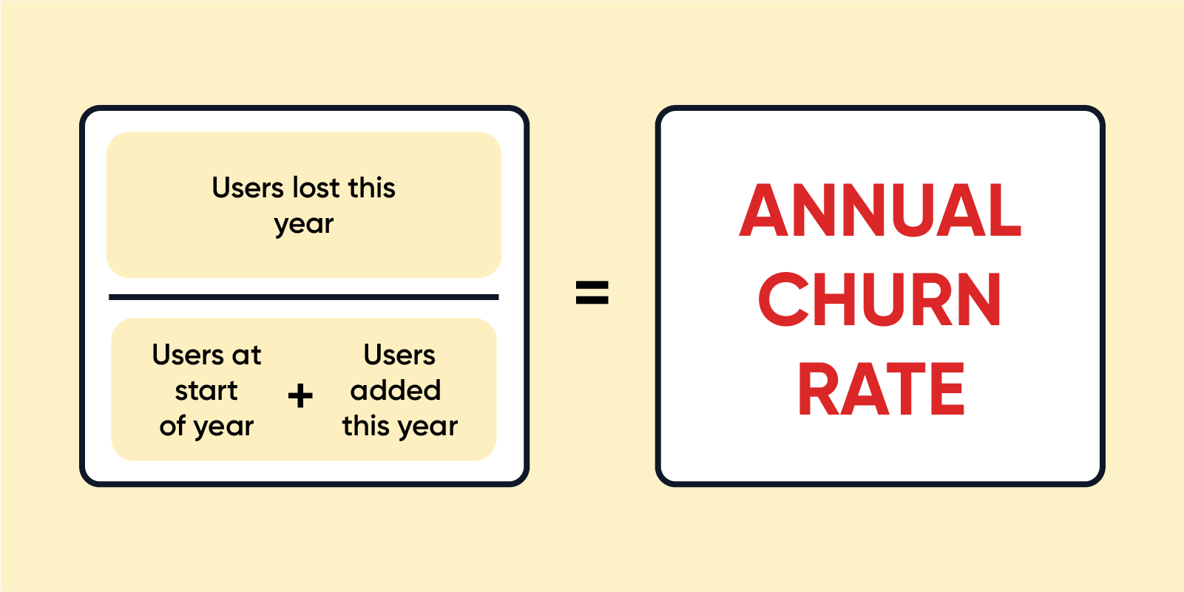
Annual Churn Rate Calculation
Here’s an Annual Churn Rate Example: Users at start of year: 50,501 New users added during year: 16,765 Users lost at the end of year: 27,890 Annual churn rate: 27,890/67,266 = 41.5%

Slide 12
Competitive Analysis
Check competitor that what he is doing in his app and you’re missing.

